Slide 1

RUNGTA COLLEGE OF DENTAL SCIENCES & RESEARCH
TITLE OF THE TOPIC: Composites
DEPARTMENT OF CONSERVATIVE DENTISTRY AND ENDODONTICS

Slide 2
Specific learning Objectives
At the end of this presentation the learner is expected to know
Core areas* H | Domain ** | Category #
Definition, indication, contraindication, composition, Classification | Cognitive | Must know
Cavity preparation, clinical procedure, bonding agent | Psychomotor | Nice to know
Methods of polymerization | Affective | Desire to know
*Subtopic of importance
** Cognitive, Psychomotor or Affective
# Must know , Nice to know & Desire to know

Slide 3
Table of Content
What are composites
Definitions
Indications
Contraindications
Advantages
Disadvantages of dental composites.
Components of composites

Slide 4
COMPONENTS OF THE COMPOSITES

Slide 5
RESIN MATRIX- a plastic resin material that forms a continuous phase and binds the filler particles. Eg BIS GAMA, TEGDEMA
FILLER- reinforcing particles and fibers that are dispersed in the matrix. example
  Silica
  Quartz

Slide 6
COUPLING AGENTS- bonding agent that promotes adhesion between filler and resin matrix.
Eg :- silane
INHIBITORS:- added to minimize or prevent spontaneous or accidental polymerization of monomers. Eg :- butylated hydroxytoluene
OPTICAL MODIFIERS:-Added for translucency and opacity.

Slide 7
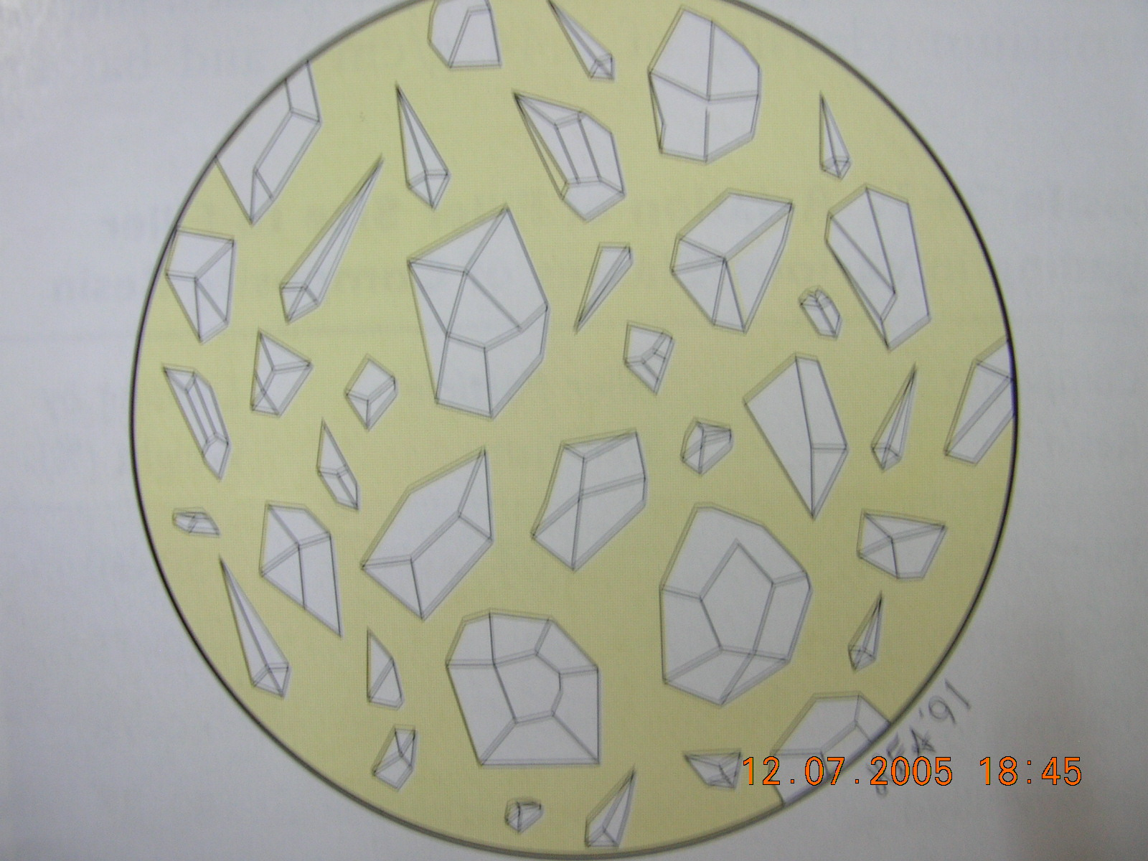

Slide 8
RESIN MATRIX
Bisphenol glycidyl methacrylate was the early resin used.
Initially the BiSGMA was very viscous and blending of filler particles was difficult.
So other matrix were introduced like UDMA (urethane dimethacrylate),TEGDMA (triethylene glycol dimethacrylate)

Slide 9
The mixture of these two resins provides adequate viscosity needed for binding with filler particles
They are mixed in 3:1 or 1:1 ratio.

Slide 10
FILLERS
Filler particles provide dimensional stability to the soft resin matrix.
The filler particles used in composite resins vary in size from less than 0.04micron to 100 micron.
filler particles reduce polymerization shrinkage
Decrease the coefficient of thermal expansion
Increase hardness.

Slide 11
Common filler particles are
Crystalline quartz
Pyrolytic silica or silica dioxide
Glasses such as
  lithium aluminum silicate ,
  barium aluminum silicate
  strontium aluminum silicate.
Other fillers like Tricalcium Phosphate & Zirconium dioxide are also used

Slide 12
COUPLING AGENTS
To bind filler particles to the resin matrix, coupling agents are used.
Coupling agent provide flexibility.
Help to transfer the stresses. provide hydrolytic stability by preventing water absorption
A properly applied coupling agent can impart improved physical and mechanical properties

Slide 13
Commonly used coupling agent are Organic silanes such as 3 methoxy propyl trimethoxy silane
Inhibit leaching by penetrating along the filler resin interface
Proper coupling by means of organosilanes is important for clinical performance of composites

Slide 14
Colouring Agents
Aluminium oxide & Titanium dioxide in 0.001- 0.007 % by wt. are commonly used
Used to produce shade , translucency, & opacity to simulate enamel & dentin
Common shades range from yellow to gray

Slide 15
Activator Initiator System
The monomers polymerize by the addition polymerization reaction initiated by
chemical activation or
External energy activation (heat light or microwave).

Slide 16
Inhibitors
They are added to the resin systems to minimize or prevent spontaneous or accidental polymerization of monomers.

Slide 17
This prevents chain propagation by terminating the reaction before the free radical is able to initiate polymerization.
An inhibitor is butylated hydroxytoluene (BHT)
They ensure sufficient working time

Slide 18
Optical Modifiers
Shading is achieved by adding various pigments.
Translucency and opacity are adjusted as necessary to simulate enamel and dentin.

Slide 19
CLASSIFICATION
BASED ON
FILLER PARTICLE SIZE
METHOD OF FILLER ADDITION
HANDLING CHARECTERISTICS
METHOD OF POLYMERISATION

Slide 20
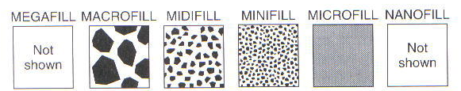
FILLER PARTICLE SIZE

Slide 21
Filler size specification
MACROFILL 10-100um
MIDIFILL 1-10um
MINIFILL 0.1-1um
MICROFILL 0.01- 0.1um
NANOFILL 0.005-0.01um

Slide 22
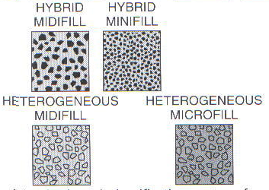
METHOD OF FILLER ADDITION:
-HYBRIDS
-HETEROGENOUS
-FIBER REINFORCED FILLER PARTICLE SIZE

Slide 23
HANDLING CHARACTERISTICS:
FLOWABLE COMSPOSITES.
PACKABLECOMPOSITE.
CORE BUILD UP.
COMPOSITE RESIN CEMENTS.

Slide 24
METHODS OF POLYMERIZATION:
SELF CURING.
ULTRAVOILET LIGHT CURE
VISIBLE LIGHT CURE
DUAL CURE

Slide 25
Failures in Composite resin
1) Post operative sensitivity
2) Microleakage (marginal leakage)
3) Voids

Slide 26
Failures
4) White Line Or Halo Around The Enamel Margin
5) Poor Retention
6) Water Sorption And Solubility
7) Degradation In The Oral Environment

Slide 27
Failures
8) Color Stability
9) Polymerization Contraction
10) Thick Consistency

Slide 28
White Line Or Halo Around The Enamel Margin
Traumatic contouring or finishing techniques.
Inadequate etching or bonding of that area.
High intensity light-curing, resulting in excessive polymerization stresses.

Slide 29
Poor Retention
Inadequate preparation form.
Poor bonding technique.
Contamination of operating area.
Poor etching.
Insufficient curing of composite resin.

Slide 30
Causes
Improper Shade Selection
Incomplete Removal Of Caries
Blood Contamination Or Unclean Instruments
Insufficient Curing

Slide 31
Polymerization Contraction
Approximate volumetric contraction for the
  macrofiller containing materials (hybrid and macrofilled composites) is 1.0-2.5%
  microfilled composites 2.0-3.5%
The polymerization contraction has a substantial impact on marginal adaptation and marginal seal.

Slide 32
Thick Consistency
The main causes of thick consistency are :
  i) uncapped syringe
  ii) refrigerated syringe
  iii) expired material

Slide 33
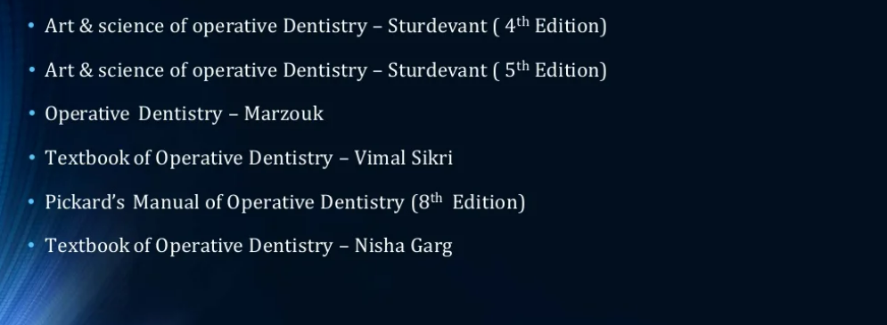
Teaching Materials

Slide 34
TAKE HOME MESSEGE/ FOR THE TOPIC COVERED (SUMMARY)
There is a wide scope of composite material in automotive, aerospace, wind energy, electrical, sports, domestic purpose, civil construction, medical chemical industries etc. Composite materials have a great potentiality of application in structures subjected primarily to compressive loads.
Composite materials have attractive aspects like the relatively high compressive strength, good adaptability in fabricating thick composite shells, low weight, low density and corrosion resistance.
Composite materials have good mechanical, electrical, chemical properties, due to which we can use composite material in many various industries.

Slide 35
Question & Answer Session
Composition of composite?
Classification of composite?

Slide 36
REFERENCES

Slide 37
THANK YOU

